Slide 1
CS6135 VLSIPDA Global Placement
Yu-Hsiang Cheng
http://m105.nthu.edu.tw/~s105062901/Myweb/

Slide 2
Homework Part

Slide 3
Related Files
Global placement
May overlap with each other
./include/GlobalPlacer.h, ./src/GlobalPlacer.cpp (Global Placement)
./include/ExampleFunction.h, ./src/ExampleFunction.cpp (Objective function and its gradient)
./include/NumericalOptimizer.h (Gradient solver)
…
Legalization
Resolve all overlaps
./include/TetrisLegal.h
./lib/libLegalizer.a
Detailed Placement
Further improve solution
./include/DPlace.h
./lib/libDetailPlace.a

Slide 4
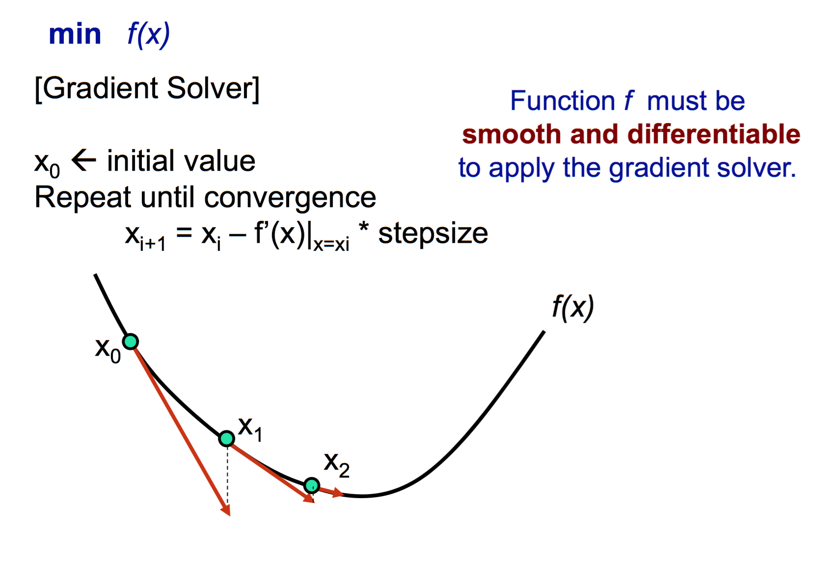
Gradient Solver
Source: Y.-W. Chang
Notes:
Gradient method
在1維空間裡 相當於函數在某一點的切線
多維空間中 代表函數在某一點的各維度偏微分的向量方向

Slide 5
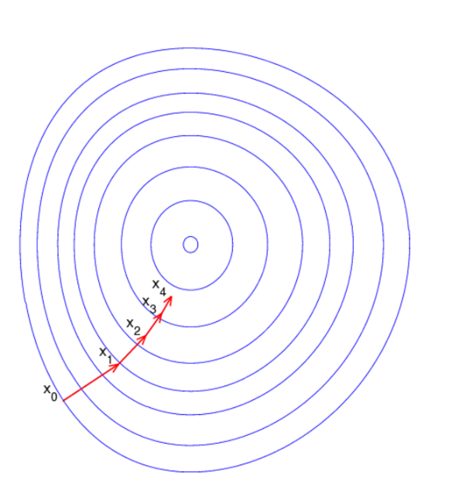
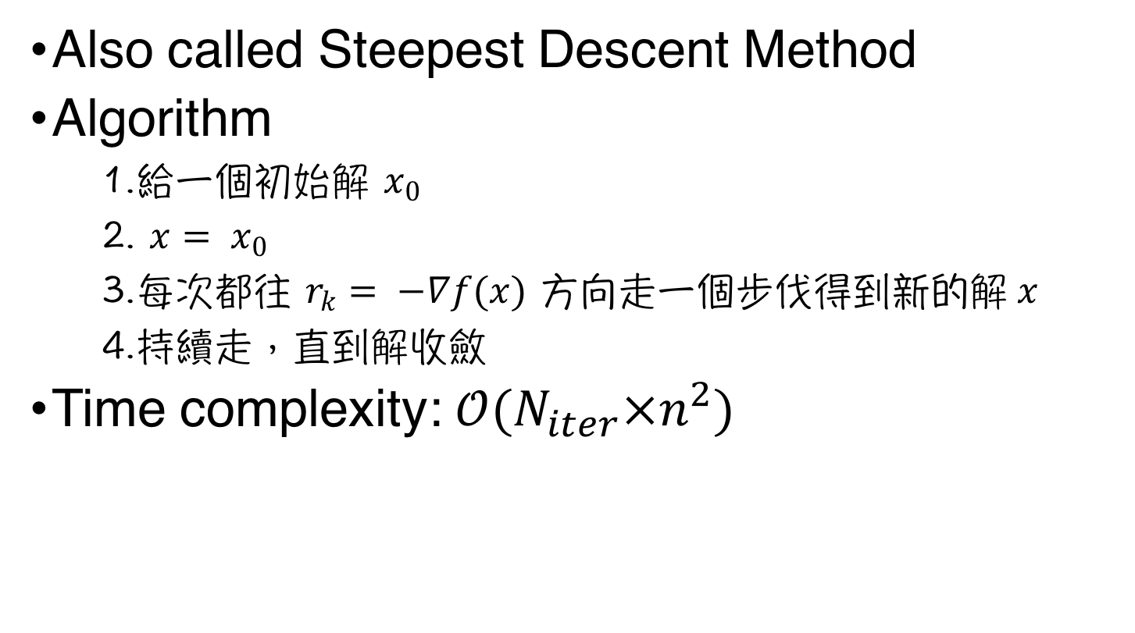
Gradient Descent Method (梯度下降法) (1/2)
Also called Steepest Descent Method
Algorithm
給一個初始解 $x_{0}$
$x= x_{0}$
每次都往 $r_{k}= −∇f(x)$ 方向走一個步伐得到新的解$x$
持續走，直到解收斂
Time complexity: $𝒪(N_{iter}×n^{2})$
Notes:
透過gradient的反方向 r_{k} 和gradient(偏微分)所計算出來的值來決定步伐長度(step size) 即可持續走到解收斂
缺點是當越接近最佳解時 (坡度變平緩) 步伐越小

Slide 6
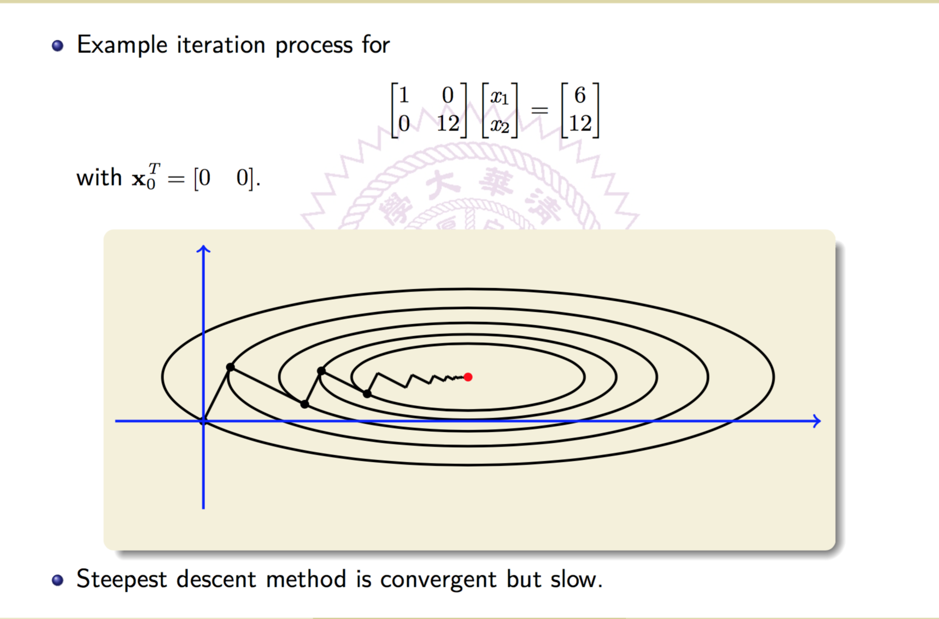
Gradient Descent Method (梯度下降法) (2/2)
Source: Mi-Chang, Chang

Slide 7
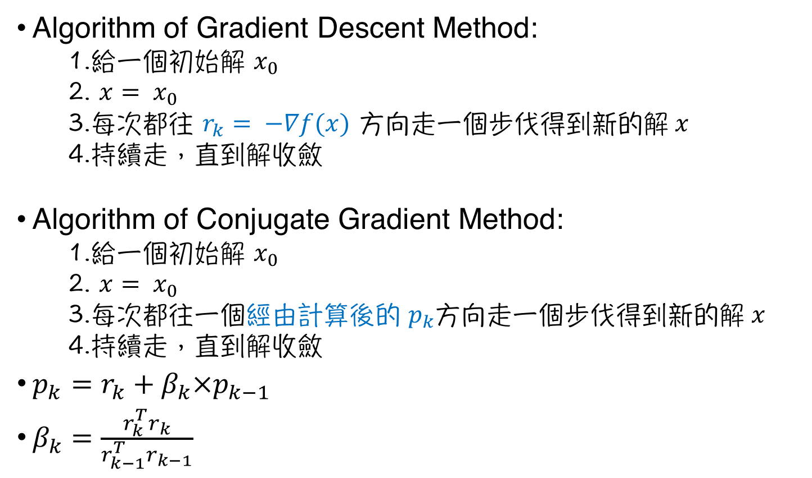
Conjugate Gradient Method (共軛梯度法) (1/3)
Algorithm of Gradient Descent Method:
給一個初始解 $x_{0}$
$x= x_{0}$
每次都往 $r_{k}= −∇f(x)$ 方向走一個步伐得到新的解$x$
持續走，直到解收斂
Algorithm of Conjugate Gradient Method:
給一個初始解 $x_{0}$
$x= x_{0}$
每次都往一個經由計算後的 $p_{k}$方向走一個步伐得到新的解$x$
持續走，直到解收斂
$p_{k}=r_{k}+β_{k}×p_{k−1}$
$β_{k}=\frac{r_{k}^{T}r_{k}}{r_{k−1}^{T}r_{k−1}}$
Notes:
剛才介紹的Gradient Descent Method 是以gradient的反方向作為搜尋方向
但是Conjugate Gradient 則是以 matrix A 的 orthogonal set 做為搜尋方向
即在每次找出新的搜尋方向,這個方向必須與之前使用的搜尋方向(p_{k}) 為共軛 (即p_{k}Ap_{j} , j=0,1,2,…,k-1)

Slide 8
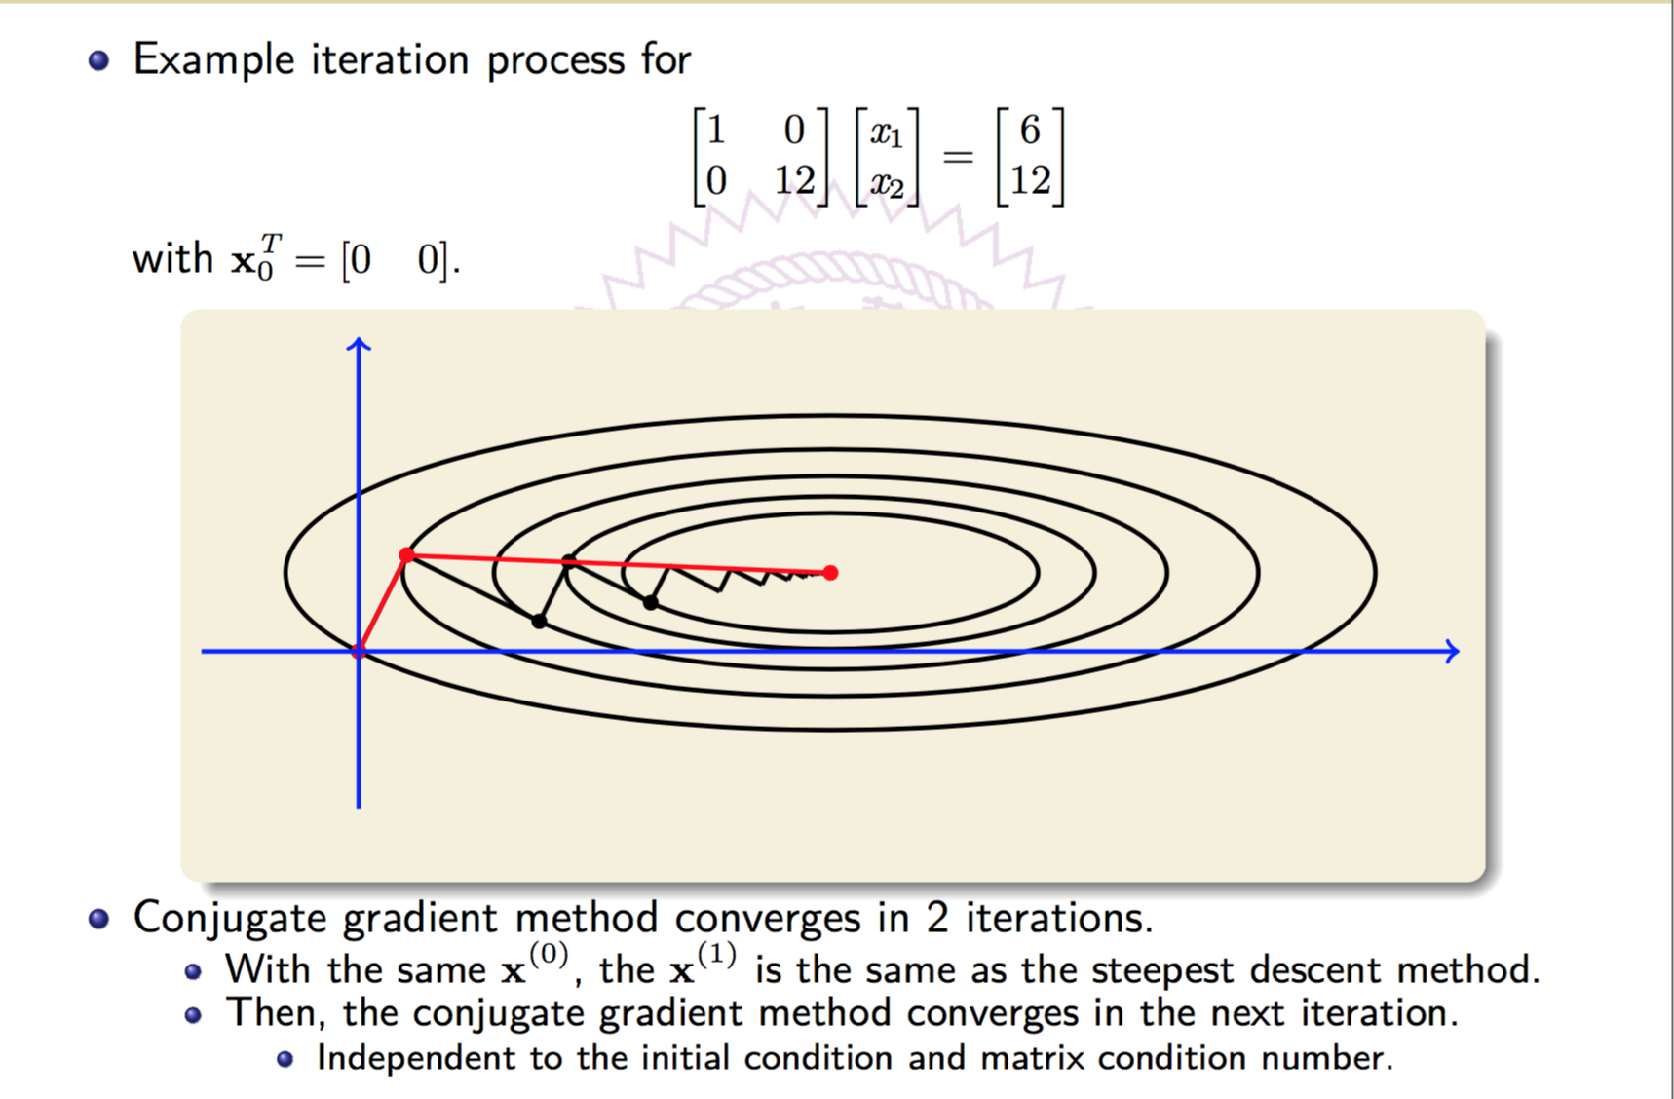
Conjugate Gradient Method (共軛梯度法) (2/3)
Source: Mi-Chang, Chang

Slide 9
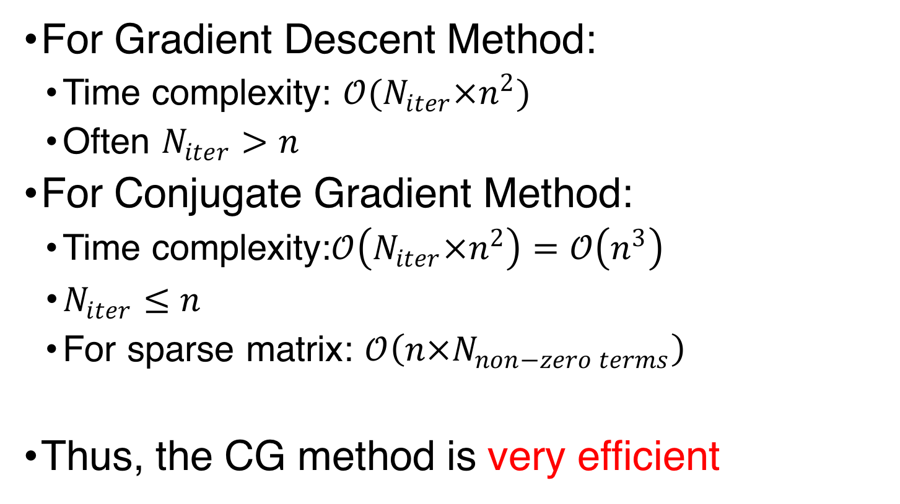
Conjugate Gradient Method (共軛梯度法) (3/3)
For Gradient Descent Method:
Time complexity: $𝒪(N_{iter}×n^{2})$
Often $N_{iter}>n$
For Conjugate Gradient Method:
Time complexity:$𝒪\left(N_{iter}×n^{2}\right)=𝒪\left(n^{3}\right)$
$N_{iter}≤n$
For sparse matrix: $𝒪\left(n×N_{non−zero terms}\right)$
Thus, the CG method is very efficient

Slide 10
HW4
$ tar -zxvf HW4.tar.gz
The gradient solver example is example.cpp
$ make example
$ ./example

Slide 11
Keys of Gradient Solver
Find a local minimum of a function
Objective function
Gradient functions
Initial vector
Number of Iterations
Tradeoff between quality and runtime
Step Size Bound
Too small: Require lots of iterations to converge
Too large: May even can not converge

Slide 12
Keys of Gradient Solver
Find a local minimum of a function
Objective function
Gradient functions
Initial vector
Number of Iterations
Tradeoff between quality and runtime
Step Size Bound
Too small: Require lots of iterations to converge
Too large: May even can not converge

Slide 13
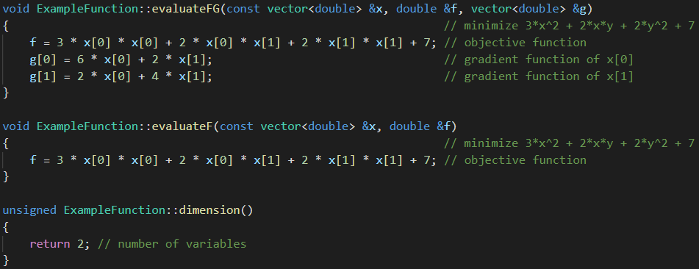
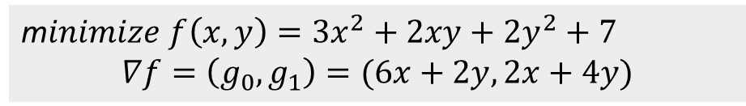
example.cpp (1/5)
m$inimize f\left(x,y\right)=3x^{2}+2xy+2y^{2}+7$
$$∇f=\left(g_{0},g_{1}\right)=(6x+2y, 2x+4y)$$

Slide 14
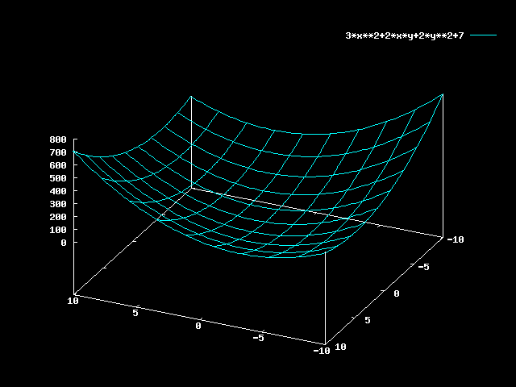
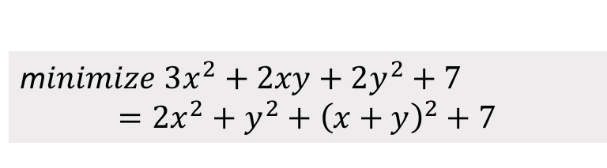

example.cpp (2/5)
m$inimize 3x^{2}+2xy+2y^{2}+7$ $$=2x^{2}+y^{2}+{\left(x+y\right)}^{2}+7$$
當$x=y=0$時，原式有極小值7

Slide 15
example.cpp (3/5)

Slide 16
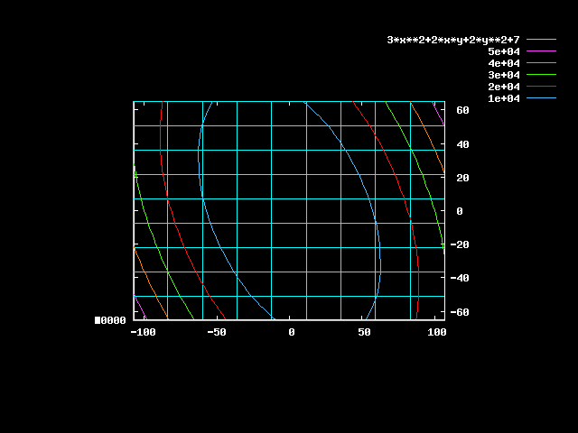
example.cpp (4/5)
sdf

Slide 17
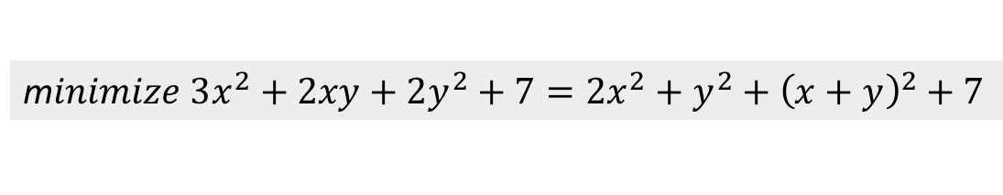

example.cpp (5/5)
m$inimize 3x^{2}+2xy+2y^{2}+7=2x^{2}+y^{2}+{\left(x+y\right)}^{2}+7$
Objective function
Absolute value of gradient functions ($\sqrt{\sum_{i}{g_{i}^{2}}}$)
[vegetablebird@ic26 HW4]$ ./hw4 -aux testcases/ibm01/ibm01-cu85.aux
Objective = 65097 ||grad|| = 1000
Objective = 60367 ||grad|| = 964.002
Objective = 55816.9 ||grad|| = 928.013
………
Objective = 7.00378 ||grad|| = 0.305804
Objective = 7.00193 ||grad|| = 0.184733
Current solution:
x[0] = 0.000796515
x[1] = 0.0306817
Objective: 7.00193
[vegetablebird@ic26 HW4]$
Iterations
Final solution

Slide 18
Keys of Gradient Solver
Find a local minimum of a function
Objective function
Gradient functions
Initial vector
Number of Iterations
Tradeoff between quality and runtime
Step Size Bound
Too small: Require lots of iterations to converge
Too large: May even can not converge

Slide 19
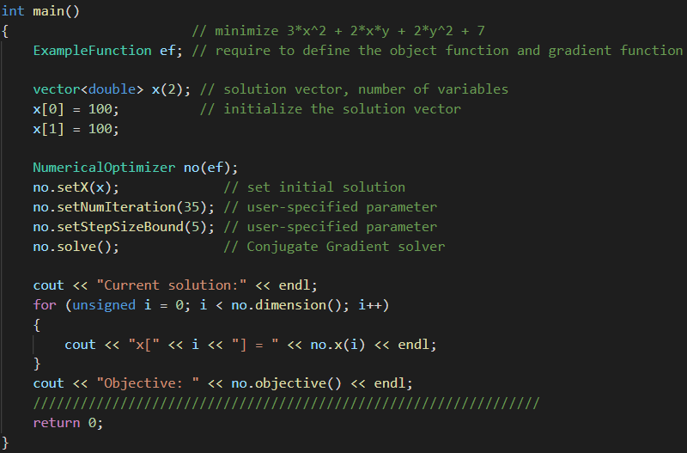
example.cpp

Slide 20
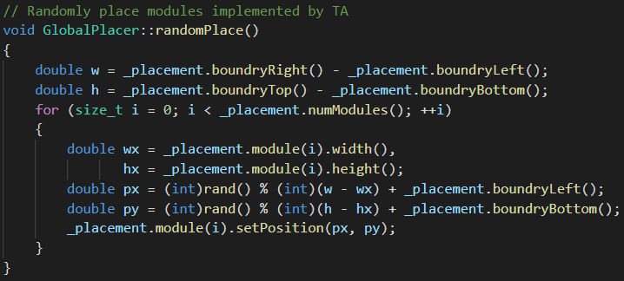
Todo (1/5)
You can refer to GlobalPlacer::randomPlace() implemented by TA

Slide 21
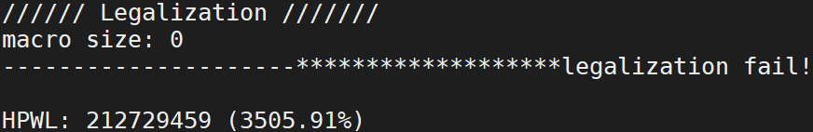
Todo (2/5)
First, just directly,
$ make
$ ./hw4 -aux testcases/ibm01/ibm01-cu85.aux
You will see the following message on the screen

Slide 22

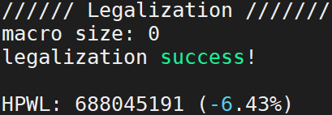
Todo (3/5)
Second, in GlobalPlacer.cpp, uncomment line 54 and 55. Then, remake and re-execute again
You will see the following message on the screen

Slide 23
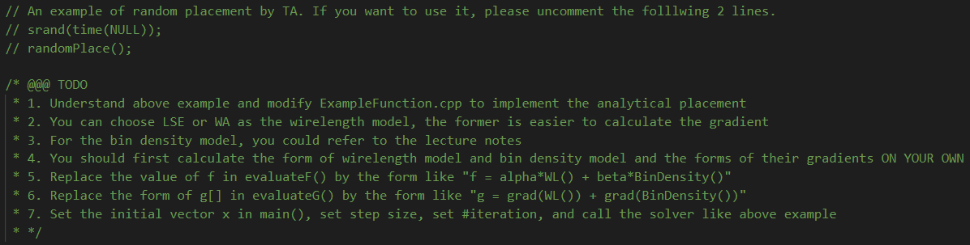
Todo (4/5)
Follow the hints in GlobalPlacer::place()

Slide 24
Todo (5/5)
Modify place() in GlobalPlacer.cpp
The upper part is an example which is the same as example.cpp
Modify evaluateFG(), evaluateF(), dimension(),… in ExampleFunction.cpp
This homework tests the following abilities
Calculus (if you use analytical approaches)
Code Reading

